Slide 1
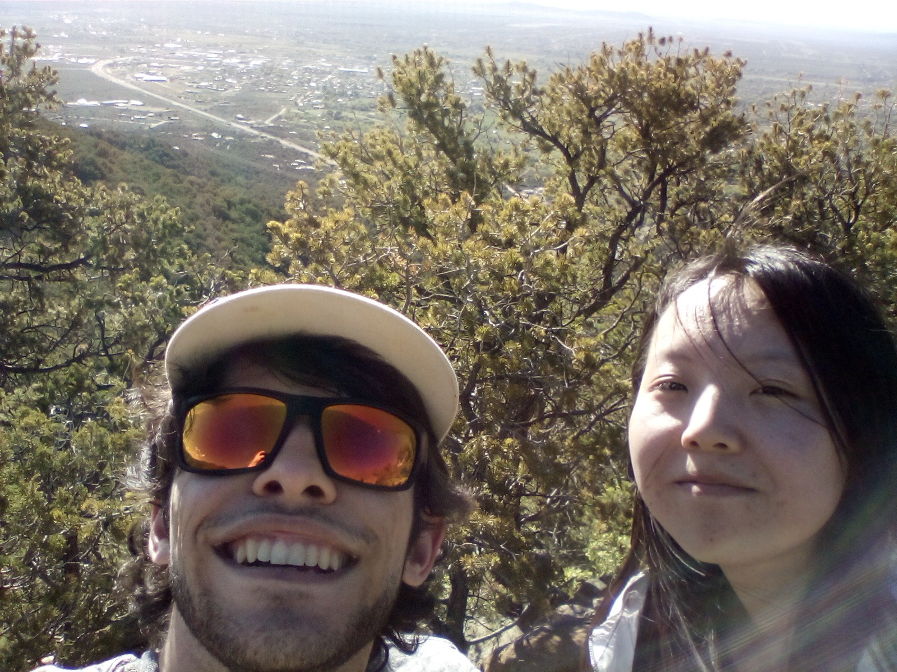


Compression by Prediction with ML
A Presentation of Summer Work of Robert Gross & Jingyi Shen

Slide 2
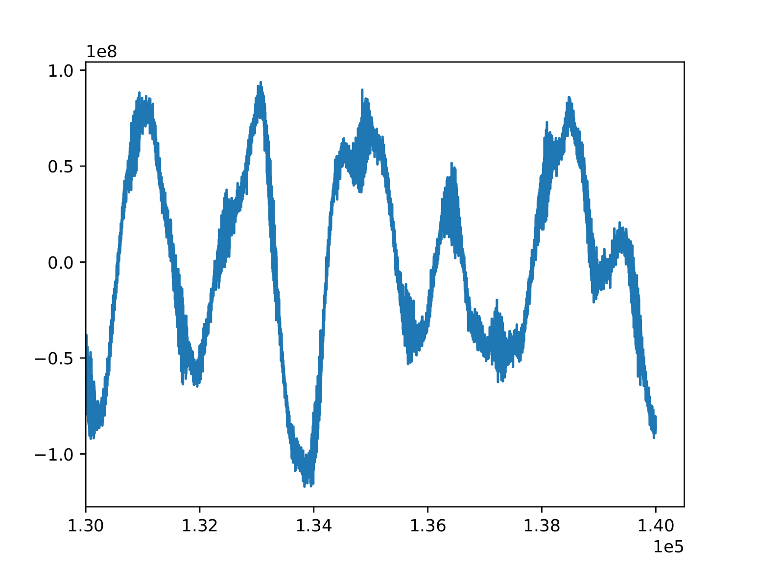
Motivation
Problem:
The MINOS Project has a lot of EM data (As an example, one day has over 4000 files where each file is half a GB!)
It becomes desirable to compress this data with the limited space available.
Lossy Compression typically compresses significantly more than lossless compression methods (while typically offering good results), so this is the preferred method
Why Machine learning?:
Although the data is highly unpredictable, it is not just a stochastic or random sequence- if the data is chunked, can the model learn to predict following segments?
There is a possibility for machine learning to work or at least a combination of machine learning and signal processing might work.
Fig 1: Original data is time series data.

Slide 3
Methods:
Long short-term memory (LSTM) for prediction
LSTM has a “memory” to keep information about past inputs.
Well-suited for processing, classifying and predicting a sequence of time series data.
LSTM Autoencoder (AE) for compression
LSTM Autoencoder is an implementation of an autoencoder for sequence data using LSTM architecture.
Convolutional Autoencoder (CAE) for compression
CAE, a type of Convolutional Neural Networks (CNNs) for unsupervised learning, can learn filters and extract features by end-to-end training.
CAE is an implementation of an autoencoder using Convolutional architecture.
XGBoost
Commonly used in machine learning competitions on Kaggle
More efficient parallel & distributed utilization of machine resources
LightGBM
Faster (but arguably less accurate) Gradient Boosting Model
Also commonly used in machine learning competitions on Kaggle

Slide 4
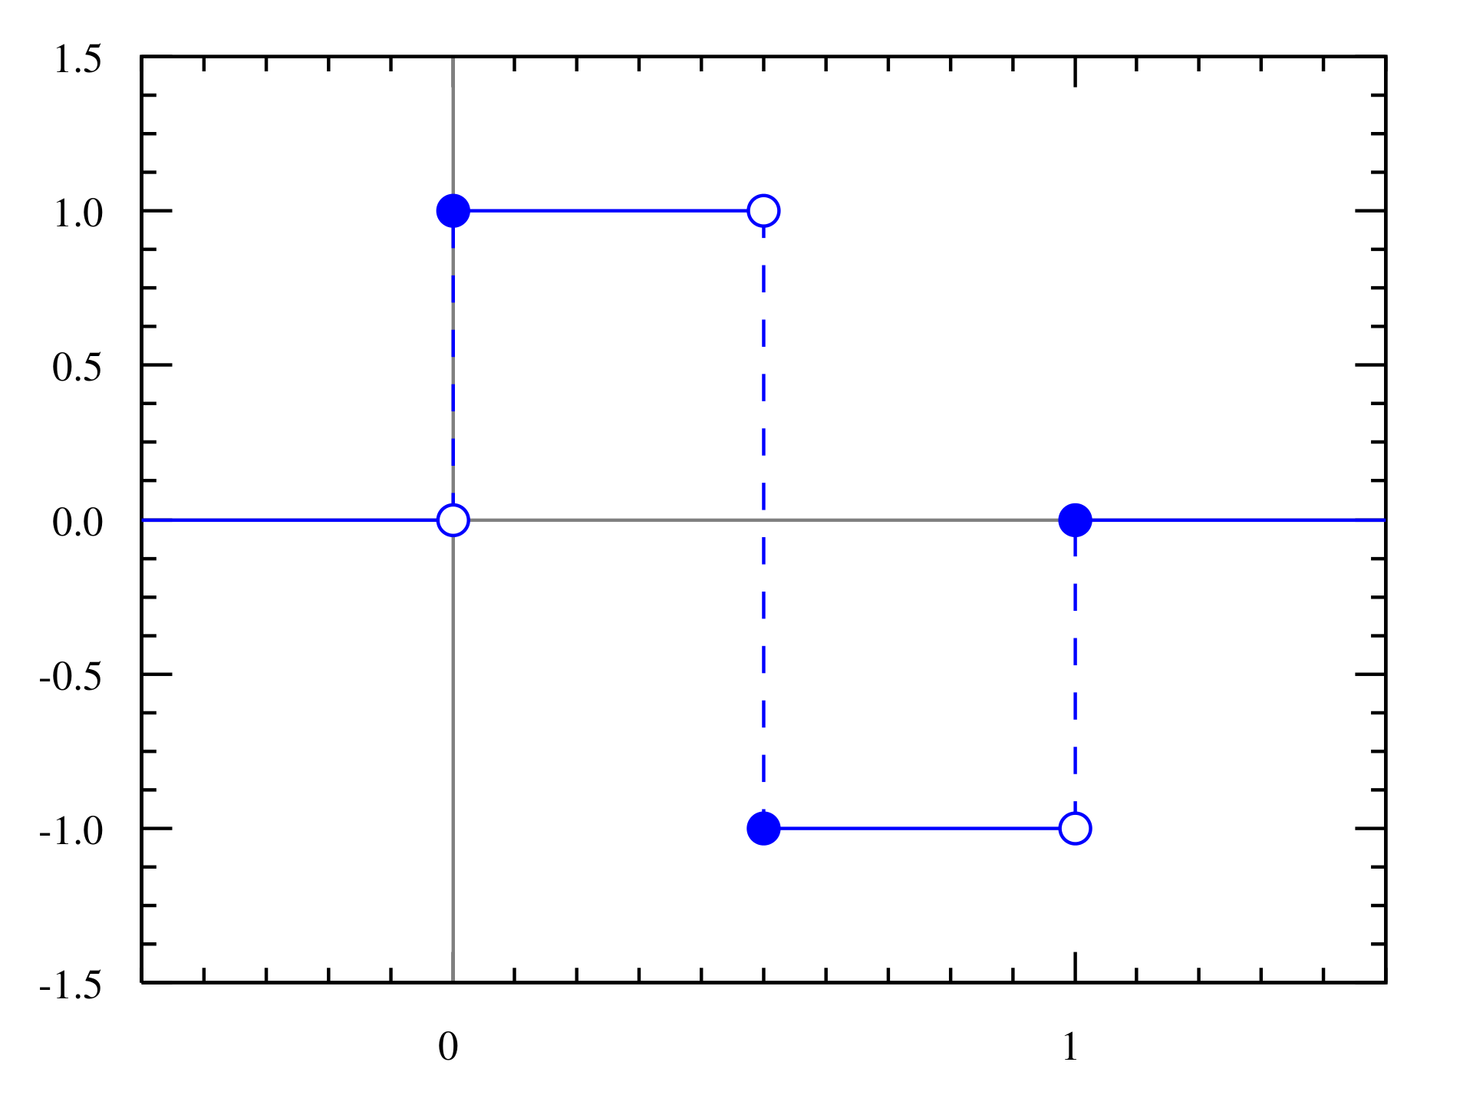
Haar Wavelet Transform
First known wavelet transform proposed in 1909 by Alfréd Haar
It can also be thought of as a special case of the Daubechies wavelet: Db1
Wavelet analysis is reminiscent of Fourier analysis due to how it lets a target function over an interval be described by an orthonormal basis
Example of usage:
Initial Vector: [1, 2, 3, 4]
Resultant Average Vector (between pairs): [1.5 3.5]
Corresponding Detail Coefficients: [-.5 -.5]
(-.5 implies that the two numbers are .5 away from the resultant average value and the negative implies that the smaller number of the 2 comes first

Slide 5
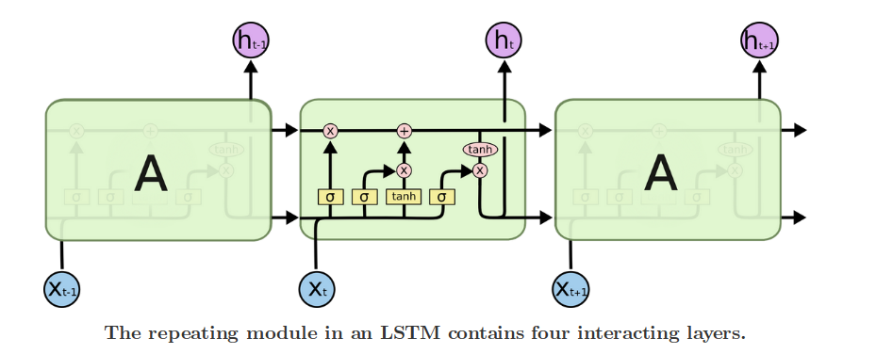
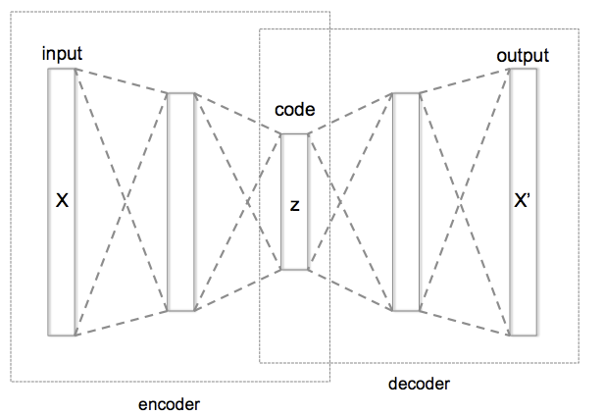
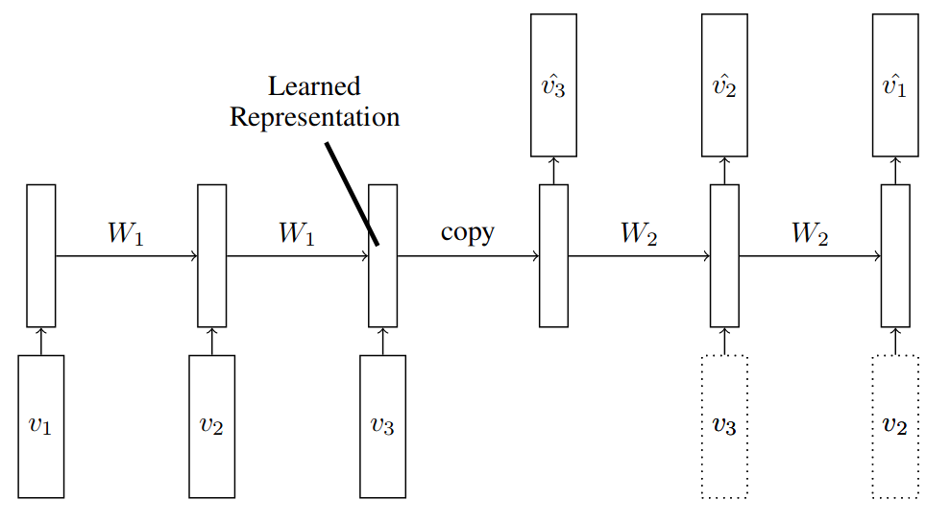
Jingyi
LSTM (for prediction):
Auto-Encoder(for compression):
Fig 2: LSTM
LSTMs have different gates to ‘forget’ and ‘remember’ what had happened before, and can make predictions based on its memory.
Fig 3: AutoEncoder
AutoEncoders can learn a compressed representation of an input and can decode the representation to recreate the input sequence.
Fig 4: LSTM Autoencoder
Given input data of sequences, LSTM Autoencoders can encode some time steps of data and decode it. The partial model for getting a learned representation can be a compression model.

Slide 6
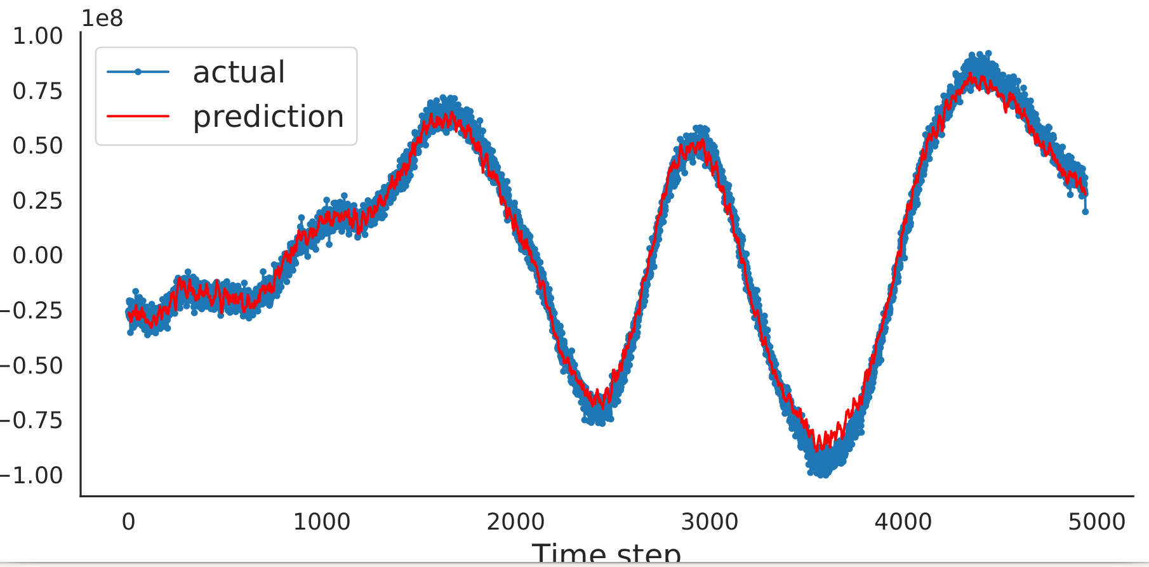
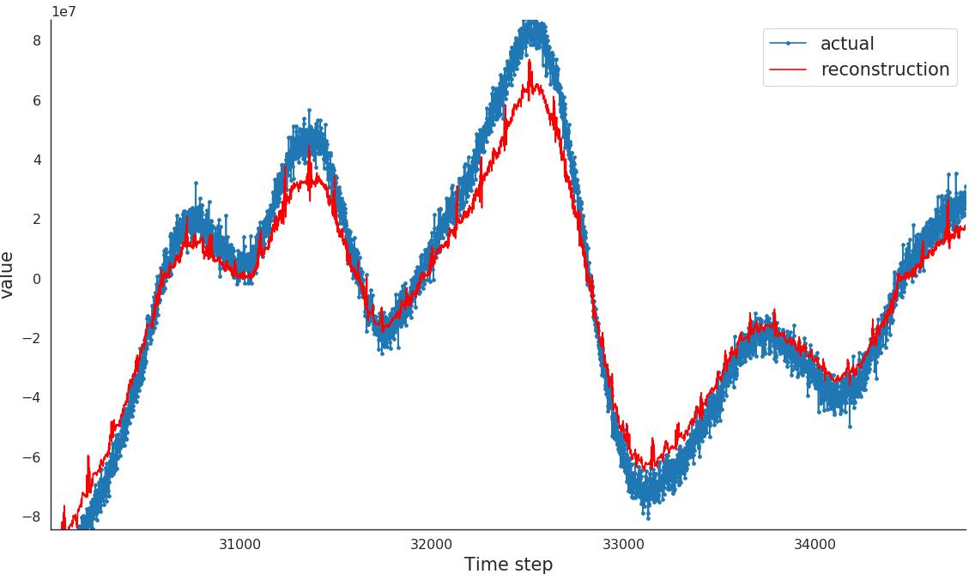
Results
Fig 5: LSTM for Prediction
Create a dataset where input X is a sequence of time series data at time (t+1, t+2, …, t+n), and the output (prediction) is the time series data at time (t+n+1, t+n+2, ..., t+n+m). Here n=m=30. Before training the model, using Z-score to normalize data.
Fig 6: Convolutional AutoEncoder for Compression
Using convolutional layers and maxpooling layers of neural network to downsample the data, using upsampling layers to reconstruct data from the compressed representation. The compression rate is 16/128 = 12.5%

Slide 7
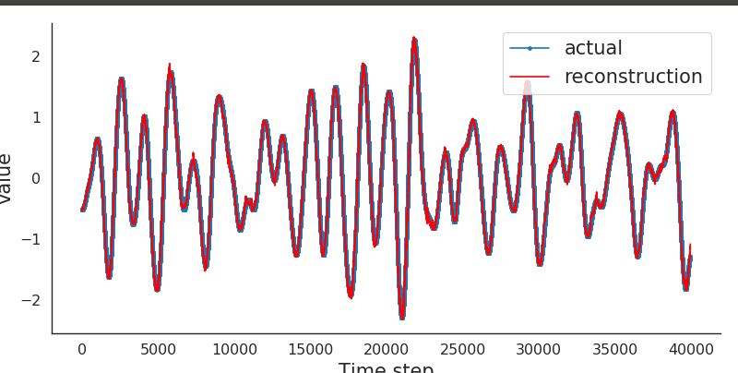
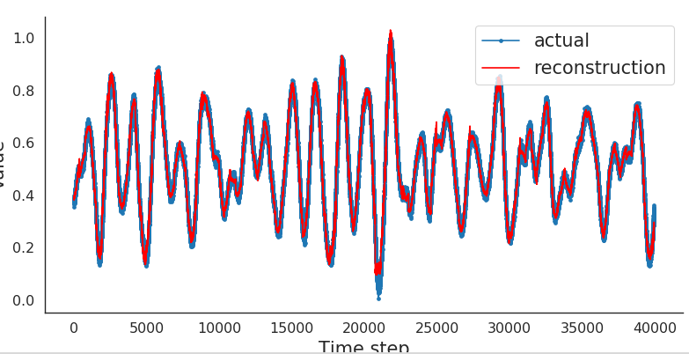
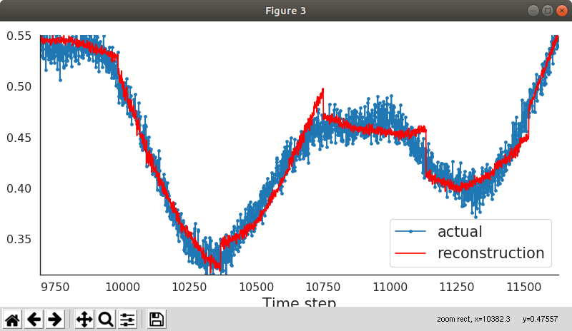
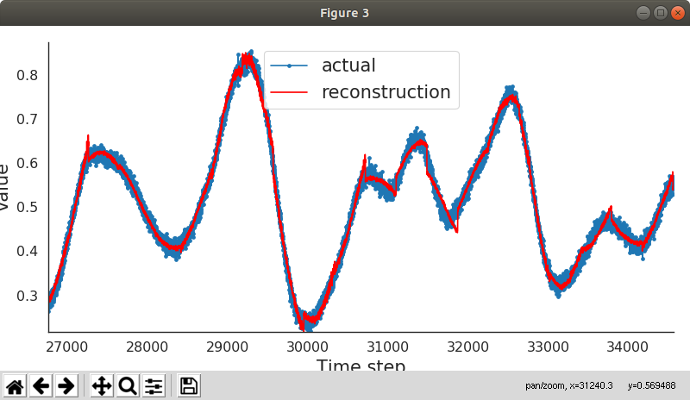
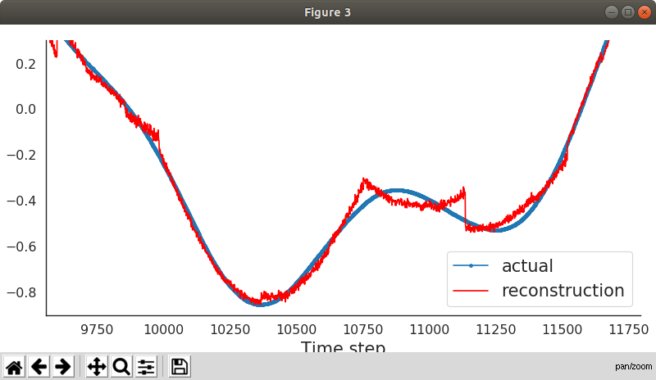
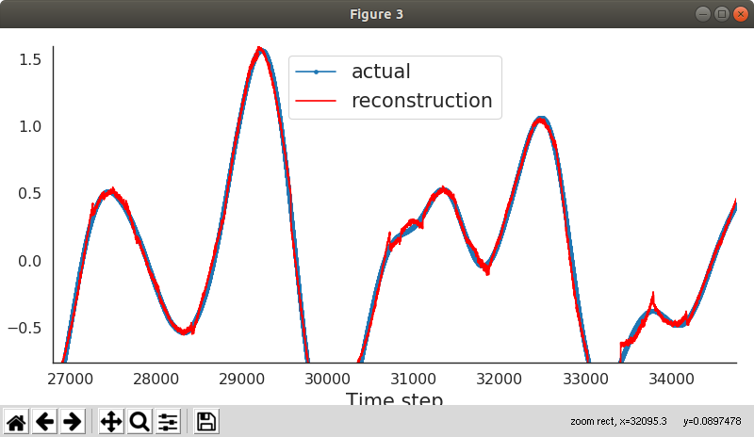
Results (Cont’d)
Fig 7: LSTM AutoEncoder for Compression (smoothed)
The input is smoothed through a sliding window. The blue line is the smoothed time series data and the red line is the decoded result of compressed representations. The compression rate is 16/384 = 4.167%
Fig 8: LSTM AutoEncoder for Compression (original)
The input is original time series data. The blue line is the time series data and the red line is the decoded result of compressed representations. The compression rate is 16/384 = 4.167%

Slide 8
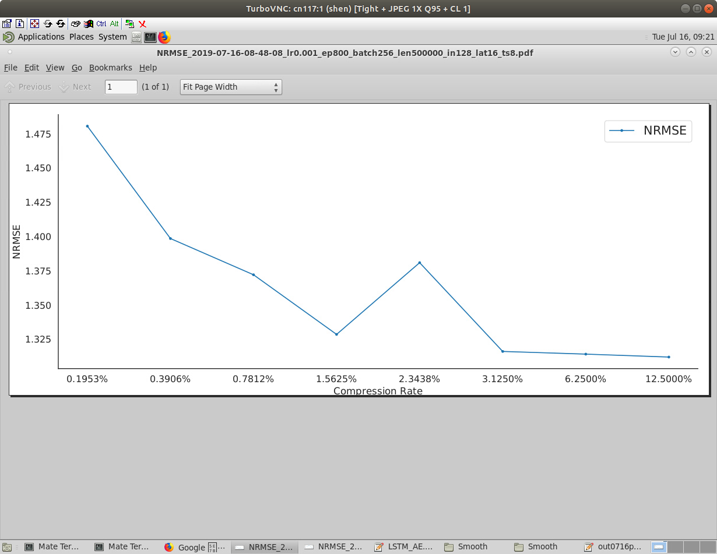
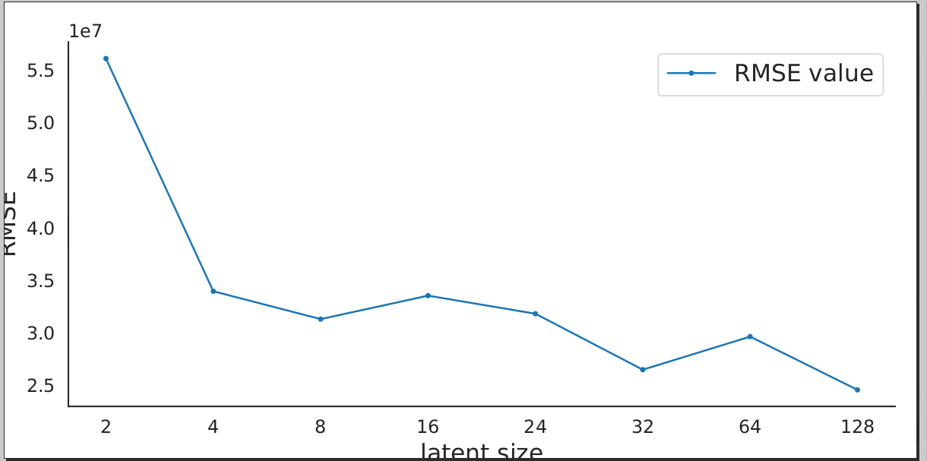
Results (Cont’d)
time step = 8
input size = 128
time step = 3
input size = 128
Fig 9: Performance of different compression rate for LSTM AutoEncoder
By controlling the time step before which the LSTM AutoEncoder output the learned representation and the size of the representation, we could achieve different compression rate. The size of representations we tried are 2, 4, 8, 16, 24, 32, 64, 128 respectively. The model computes a representation every 8 time steps. Every time step the input size is 128, so the compression rate are: 2/(128*8)=0.1953%, 4/(128*8)=0.3906%, 8/(128*8)=0.7812%, ..., 128/(128*8)=12.5000%. The performance is evaluated by NRMSE.
Fig 10: Performance of different representations’ size for LSTM AutoEncoder
The size of representations (latent size) we tried are 2, 4, 8, 16, 24, 32, 64, 128 respectively. The model computes a representation every 8 time steps. Every time step the input size is 128. The performance is evaluated by RMSE.

Slide 9
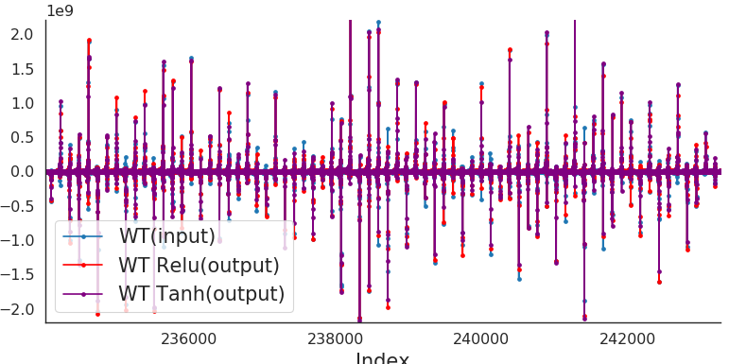
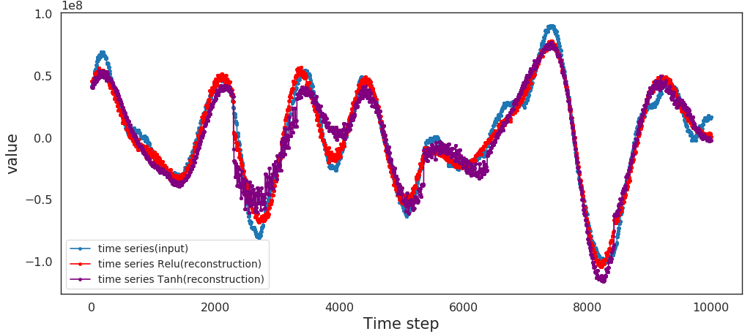
Results (Cont’d)
Fig 11: LSTM AutoEncoder for Compression (wavelet transform)
The input is part of wavelet transform of original time series data. Output is decoded result of input’s compressed representations. Blue dots, red dots and purple dots are: input, output with Relu as the model’s activation function and output with Tanh as the model’s activation function.
The compression rate is 16/384 = 4.167%
Fig 12: LSTM AutoEncoder for Compression (wavelet transform)
They are reconstructed time series results from the wavelet transform. Note for the input of LSTM AutoEncoder, we already discard some detail coefficients of wavelet transform, we only use partial to reduce the computational complexity without losing too much accuracy.

Slide 10
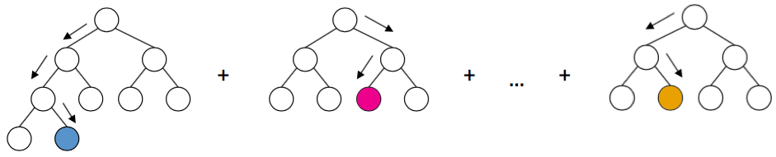
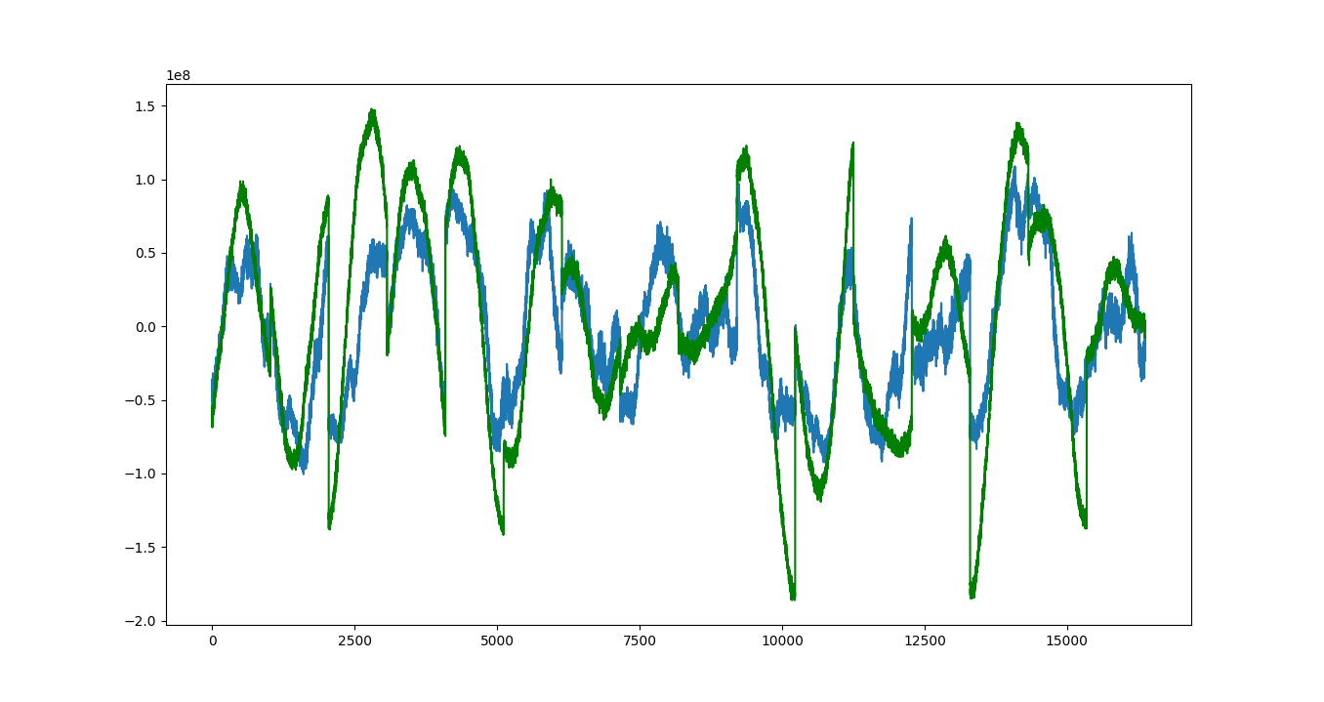
Rob LightGBM
Utilizes an ensemble of weak learners- classifiers which are only somewhat correlated with the true classification such that they are better than just guessing randomly at labeling. (Typically shallow decision trees)
Very similar functionality to XGBoost (released in 2017 by Microsoft Research)
Typically works a little faster than XGBoost while providing similar quality of results
Goal: Use section of data to predict the next section of data
Try with:
original chunked data
chunked data transformed into a wavelet
both original chunked signal & wavelet details coefficients
use dimensionality reduction to remove unhelpful features
Results from looking at first 8 chunks of data and using both the original data and wavelet details
Green = True
Blue = Prediction

Slide 11
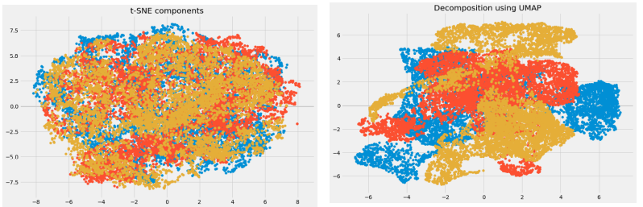
UMAP
“Uniform Manifold Approximation and Projection”
Dimensionality Reduction Technique released in 2018
Non-Linear method that usually works better than T-SNE:
Better at working with large quantities of data
Significantly Quicker (Usually 20x or more faster)
Preserves global structure better

Slide 12
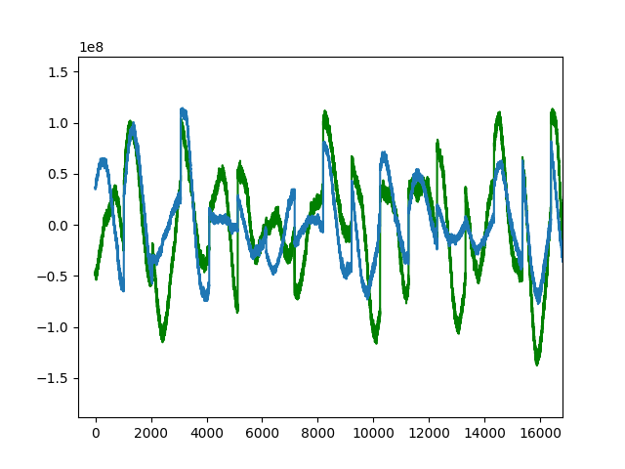
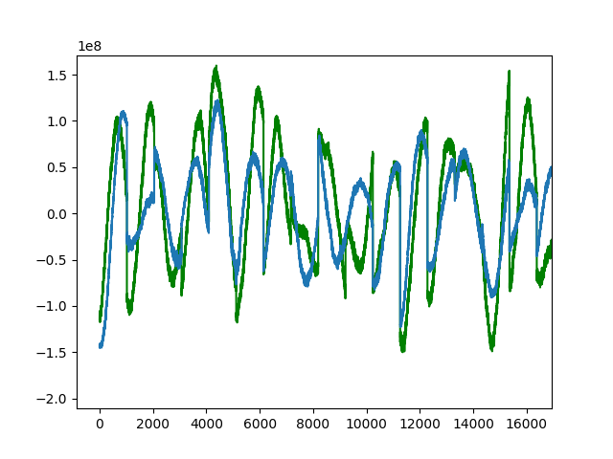
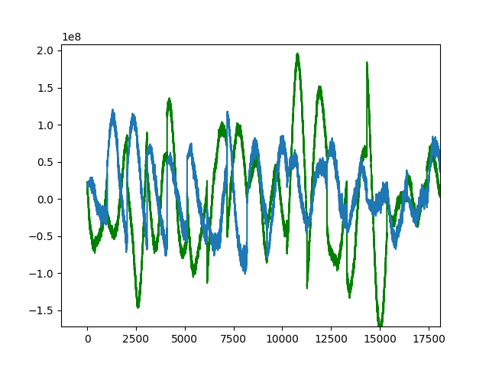
Results (Top Results by NRMSE via Mean)
NRMSE: 1.25805
Reduction Method: PCA
Data Usage: Wavelet
Components: 2
Training Time: 287.559 s
NRMSE: 1.26648
Reduction Method: UMAP
Data Usage: Signal Only
Components: 2
Training Time: 338.232 s
NRMSE: 1.34018
Reduction Method: None
Data Usage: Signal Only
Components: N/A
Training Time: 4320.218 s

Slide 13
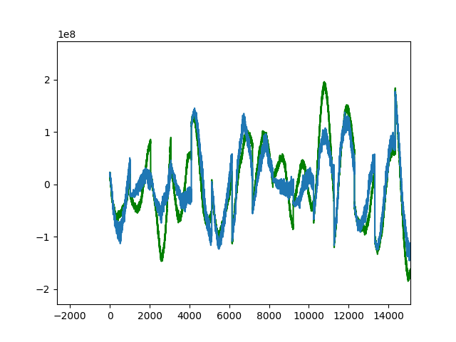
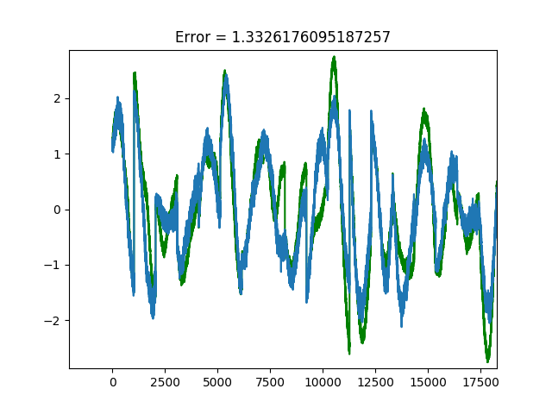
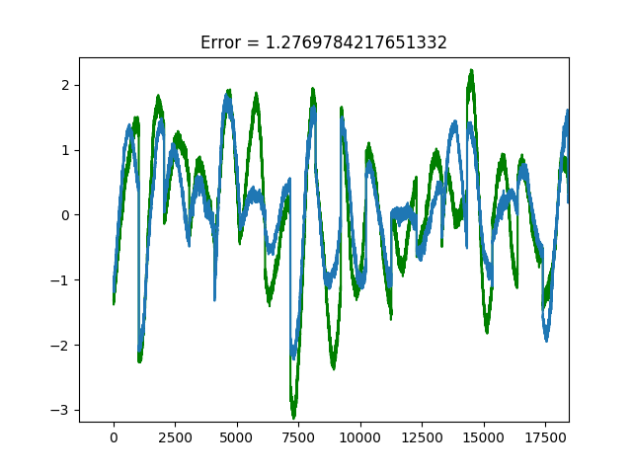
Results (Top Results by NRMSE via Range)
NRMSE: .176001
Reduction Method: None
Data Usage: Both
Components: N/A
Training Time: 7018.456 s
NRMSE: .179559
Reduction Method: PCA
Data Usage: Wavelet
Components: 50
Training Time: 383.728
NRMSE: .183239
Reduction Method: UMAP
Data Usage: Both
Components: 3
Training Time: 308.205

Slide 14
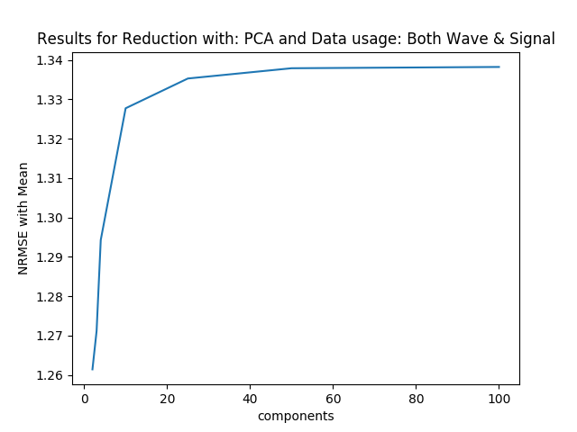
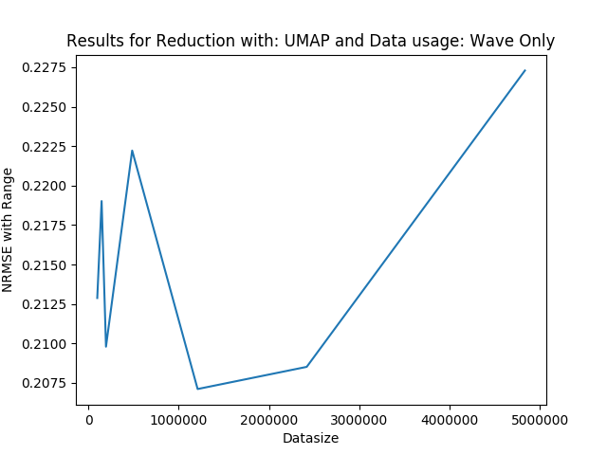
Compression Versus Error

Slide 15
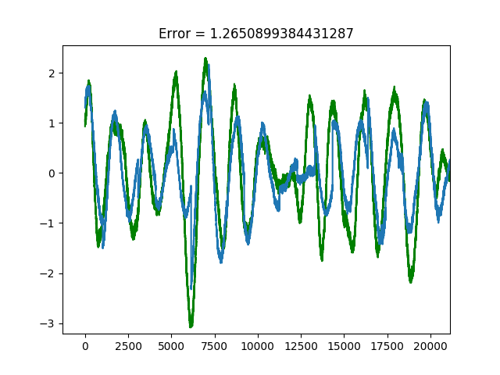
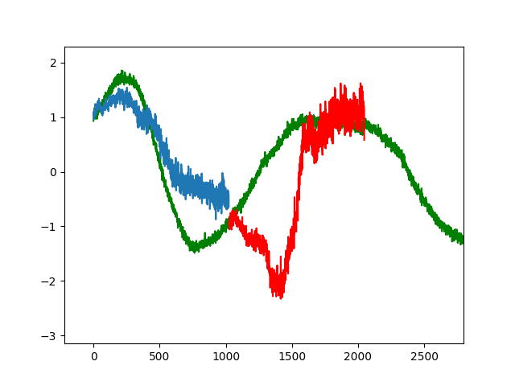
(Kind of) Future Work
Full Reconstruction
Iterative Method

Slide 16
References
S. Di and F. Cappello. Fast error-bounded lossy HPC data compression with SZ. In IPDPS 2016, pages 730–739, 2016.
T. Chen and C. Guestrin. Xgboost: A scalable tree boosting system. In Proceedings of the 22Nd, ACM SIGKDD International Conference on Knowledge Discovery and Data Mining, pages 785–794. ACM, 2016.
G. Ke, Q. Meng, T. Finley, T. Wang, W. Chen, W. Ma, Q. Ye, and T.-Y. Liu. Lightgbm: A highly efficient gradient boosting decision tree. In Advances in Neural Information Processing Systems, pages 3149–3157, 2017.
McInnes, L. & Healy, J. UMAP: uniform manifold approximation and projection for dimension reduction. Preprint at https://arxiv.org/abs/1802.03426 (2018).

Slide 17
References
Greff, K., Srivastava, R. K., Koutník, J., Steunebrink, B. R., & Schmidhuber, J. (2016). LSTM: A search space odyssey. IEEE transactions on neural networks and learning systems, 28(10), 2222-2232.
Gensler, A., Henze, J., Sick, B., & Raabe, N. (2016, October). Deep Learning for solar power forecasting—An approach using AutoEncoder and LSTM Neural Networks. In 2016 IEEE international conference on systems, man, and cybernetics (SMC) (pp. 002858-002865). IEEE.

